Slide 1
User Log-in System
Cyber Security / Project Presentation
Yusuf Korkmaz

Slide 2
Introduction
Main idea
User log-in systems
Hacking with Brute Force
Security examples
How it works
Conclusion

Slide 3
Main Idea
Recognizing users looking the usage patterns of keyboard
There are 4 types information on keystroke dynamics characterized by keys presses latencies;
Between two presses
Between two releases
Between press and release
Between release and press

Slide 4
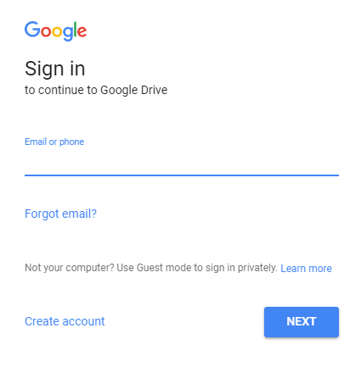

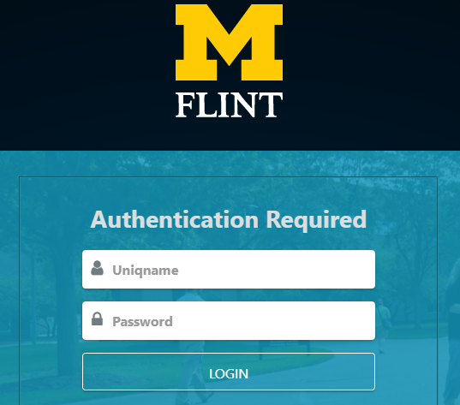
User Log-in Systems
Select * from user_account where username = unameTextbox.getText() and password = passwordTextbox.getText()

Slide 5
Hacking
Brute force attack
Checks all possible passwords
A hacker can find the password and steal our identity.

Slide 6

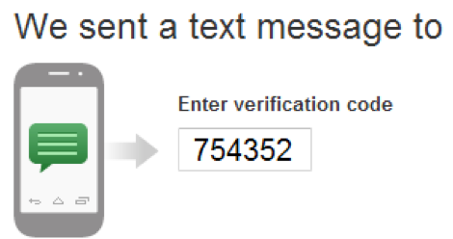
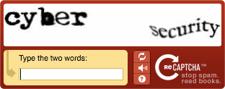
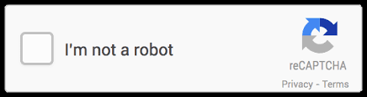
Security

Slide 7

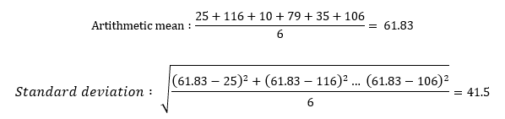
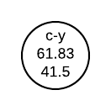
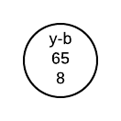
How It Works

Slide 8
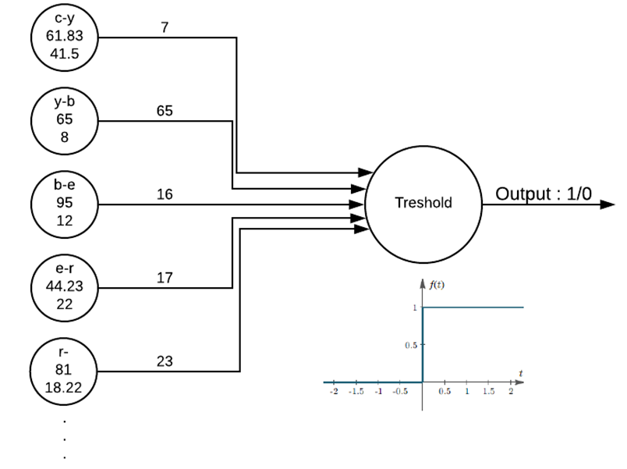
How it Works - 2

Slide 9
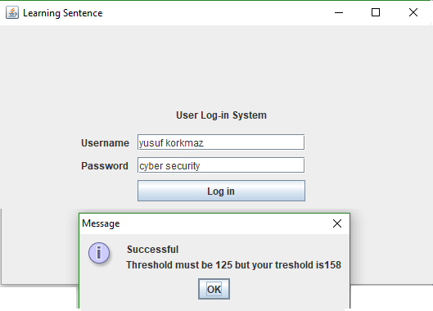
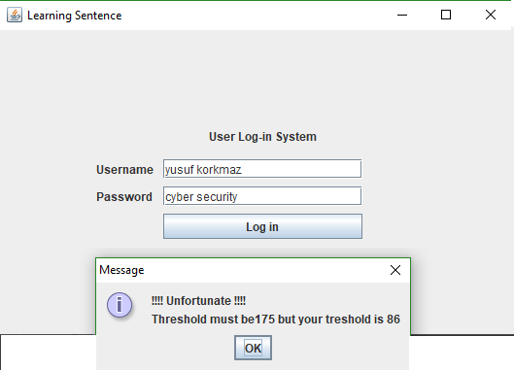
How it Works - 3
c-y-127/y-b-98/b-e-46/e-r-46/r- -46/ -s-129/s-e-40/e-c-40/c-u-141/u-r-25/r-i-86/i-t-60/t-y-46/ (different user)

Slide 10
Conclusion
More secure
Usage pattern is changeable
Not good as I think
It is very good to think that a system will have an ability to recognize user.

Slide 11
THANK YOU

Slide 12
How it Works - 3
c-y-78/y-b-78/b-e-141/e-r-63/r- -31/ -s-31/s-e-79/e-c-63/c-u-15/u-r-31/r-i-93/i-t-47/t-y-32/ (another PC) c-y-79/y-b-67/b-e-88/e-r-36/r- -61/ -s-82/s-e-66/e-c-40/c-u-137/u-r-11/r-i-7/i-t-34/t-y-87/ c-y-106/y-b-51/b-e-84/e-r-65/r- -107/ -s-56/s-e-66/e-c-61/c-u-157/u-r-52/r-i-85/i-t-82/t-y-40/

